Slide 1
Streamlining Medicaid Enterprise Systems Updates on the Medicaid Detailed Budget Table Process and Template
State Information Session
Medicaid Enterprise Systems (MES) Operations Team
March 25, 2026
For Public Release
Notes:
We will also have additional trainings on the recently approved templates

Slide 2

Objectives
This session provides an overview of the changes to the Medicaid Detailed Budget Table (MDBT) Requirements for Medicaid Enterprise System (MES) Submissions
Understand the changes to the MDBT submission process
Understand the roles and responsibilities in submitting MDBTs
Understand how the new MDBT Template is organized
Understand how to transition to the new MDBT template and process

Slide 3
Goals
Improve Timeliness from Submission to Decision
Improve Customer Service to States
Reduce friction for implementation of the new MDBT template

Slide 4
Current MDBT Challenges
Current Process
Every APD must have a consolidated MDBT built on the last MDBT
Each submission is dependent on the one ahead of it, resulting in a First In, First Out (FIFO) clearance process
Benefit
High level of real-time financial accounting and reporting accuracy
Concerns
States must plan submissions in the order of priority based on CMS's ability to approve
Bottlenecks with out-of-sequence approvals
Adds additional steps to update any downstream MDBT if any of the APDs ahead of need revisions
Notes:
Consolidate MDBT refers to the compiled list of MDBTs for each project, with the total costs listed

Slide 5
Revisions to the MDBT Process
New Process
Every APD will only be required to have a project-level MDBT (i.e., no consolidated MDBT is required)
Submissions are no longer dependent on FIFO (the one ahead of it)
Benefit
Allows out-of-sequence submissions and approvals for APDs
No rework for consolidated MDBTs
Improves the flexibility of submission order to CMS
State has access to the CMS Master consolidated MDBT at all times

Slide 6
New Process
State
MES Submission
State Officer
Review
Clearance
Decision
Project Only MDBT
Approval Letters will only have the Project MDBT
State
Post Approval Review of Project Consolidated MDBT
Provides a Recommendation

Slide 7
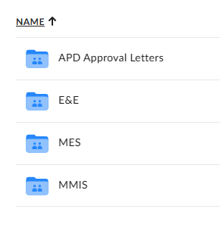
Roles and Responsibilities
MES State Officers
Will share the State-specific MDBT Box folder with their states
States
Will need to validate the current, full MDBT funding for E&E and MMIS
Transition to the new MDBT format can occur at the same time, ahead of the July 1 required date.
Verify that State POC has ready only access to the folders
Notes:
Full Project funding history not based on the current MDBT (which may remove previously approved funding)

Slide 8
Roles and Responsibilities (Submission)
States
APD submission will include the project(s) MDBT only
Project-consolidated MDBT is not required as part of the submission
MES State Officers (SOs)
During the APD Review
MDBT review will be project-focused, reviewing both in-state and private contractor costs
Post Approval Review
Review CMS maintained project-consolidated MDBT
Send monthly reminders for States to review their project-consolidated MDBTs
Notes:
We will provide language for the monthly reminder; most attention will be new MDBT post when we split the line items yet

Slide 9
Roles and Responsibilities (Post-approval)
Medicaid Enterprise Systems Operations Team
MES Ops will update and maintain the project-consolidated MDBT post approval
MES State Officers
Monthly, will send an email to their states to review their project-consolidated MDBT
States
Review the project-consolidated MDBT
Report any concerns, errors, or questions to your MES State Officers
Notes:
Instructions on how to share the folders has been previously been shared

Slide 10
New MDBT Templates
Required for all submissions starting July 1, 2026

Slide 11
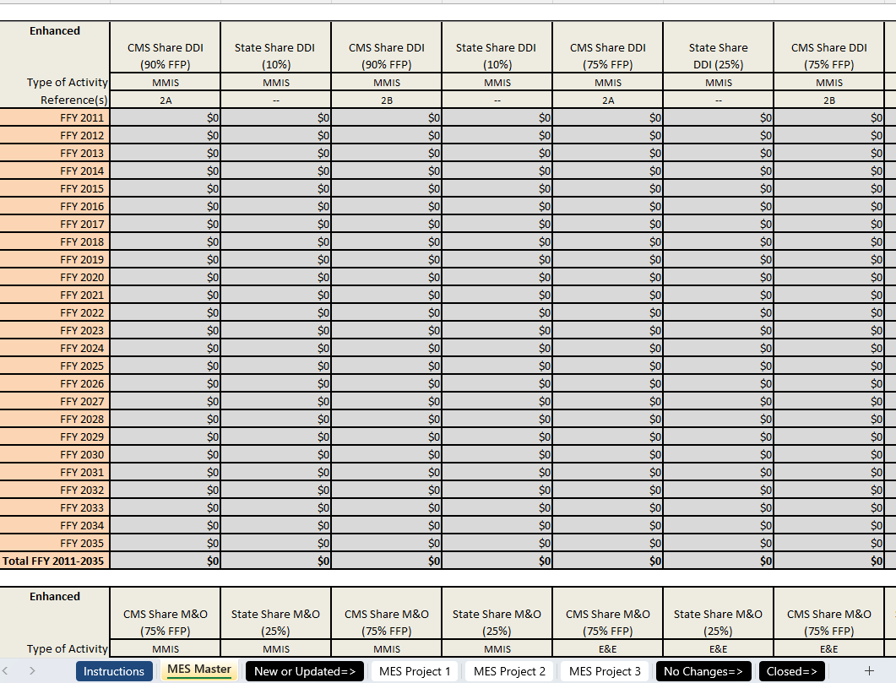
MES Master Tab MDBT Template
Sums all the funding for all projects together
Covers Federal Fiscal Years 2011 - 2035
Enhanced
Non-enhanced
Totals

Slide 12
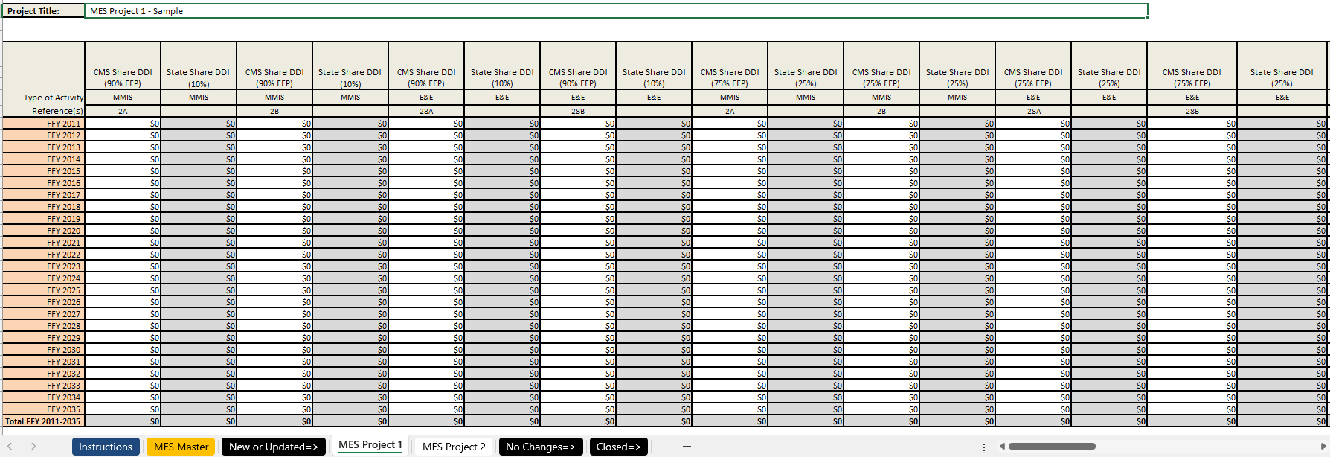
Project Specific MDBT Template
Project Title
Enhanced
Non-enhanced
CHIP
Totals
Make sure the tab name is the project name

Slide 13
The Project Specific MDBT
 | Old MDBT | New MDBT
MMIS and E&E Costs | Separate MDBTs | Unified MDBT
MBES Line items | Unified In-House and Private Sector Costs Categories (e.g., 5AB) | Separate In House and Private-Sector Cost Categories (e.g., 5A and 5B)
Line 49* | Not included | Included**
CHIP Funding* | Not included | Included**
Approval Letter | Includes Project and Consolidated MDBT | Project-specific MDBTs Only
*Will not be approved in the MES Approval Letters
**Not included in the MES Master tab

Slide 14
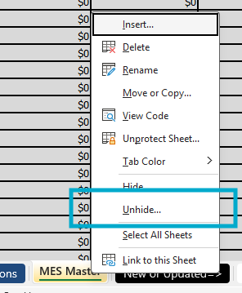
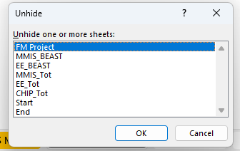
MES Master MDBT
In addition to the MES Master tab and project tabs, there are "hidden" tabs
Right click on tabs
Click "Unhide"
Select one or many sheets to unhide

Slide 15
The Hidden Tabs MDBT
Tab Name | Use
FM Project | Allows the user to filter a specific project MDBT
MMIS_BEAST | Total MMIS funding for all projects, combining all In-House and Private Contractor Costs (e.g., 2A+2B)
EE_BEAST | Total E&E Funding for all projects, combining all In-House and Private Contractor Costs (e.g., 28A+28B)
MMIS_Tot | Total MMIS funding for all projects, separate out In-House and Private Contractor Costs(e.g., 2A and 2B)
EE_Tot | Total E&E funding for all projects, separate out In-House and Private Contractor Costs (e.g., 28A and 28B)
CHIP_Tot | Total CHIP funding for all projects

Slide 16
Transitioning to the new MDBT format
States will complete a one-time transition from the separate MMIS and E&E MDBT to the new MES MDBT template
Once the transition is complete, do not submit the previous MDBT format to CMS
Keep project names intact, but if there is a need to change the project name
Change the project tab name to the new name
Add "Prev [Old Project Name]"
Once the new MDBT transition has been validated, only project-specificspecific MDBTs will be required
Coordinate with your MES State Officer and your internal stakeholders on when to complete the transition

Slide 17
One Time Transition to the new MDBT Format
✓ DO | ✗ DON'T
Compile a complete record of approved MMIS and E&E funding | Send partial MDBTs with incomplete FFY data
Use Project Names ONLY for tab names | Add "APD," "MMIS," or E&E" to project tab names
Place funding on prior to and including FFY 2026 on in-house line items (no retroactive splitting) | Add custom elements to the MDBT (e.g., multi-OPDIV allocations)
Verify FFP values are accurate | Worry about small rounding difference in the state share (some states modified the MBDT so the state share formulas are no longer accurate)
Input previously approved funding in the "in-house" cost (e.g., 5A) | Retroactively split approved funding prior to FFY 2026
Use whole numbers only for funding amounts | Use cents for funding amounts
Notes:
Will need at least one E&E tab, CE tab will be separate and total E&E project costs will be included in the hidden E&E tabs

Slide 18
State Demo of New MDBT Transition
[Placeholder]

Slide 19
New MDBT Process with the new MDBT
Post Transition
States are encouraged to maintain their own copy of their project-consolidated MDBT
States will only send project-specific MDBTs with their submissions
MES State Officers and States
Continue to work together to manage submission volume
Non-sequential APD approvals will give you more flexibility to plan a flow of submissions
Notes:
Once the transition occurs, should make the transition to the new MDBT more focused on the projects while CMS manages the project consolidated

Slide 20
Key Takeaways and Upcoming Dates
Post rollout to the States Key Changes:
States must provide full MDBTs for MMIS and E&E funding (old or new format)
State APD submissions will only include project level MDBTs
Approval Letters will only have project level MDBTs
State Officers will need to work closely with states to ensure timely validation of consolidated MDBT data
Important Dates
March 11, 2026: Project MDBT transition begins; requires finalized MDBT for MMIS and E&E
July 1, 2026: New MDBT format will be required
Notes:
We can start the validation anytime. Don't need to wait to submit an APD for us to validate the MDBT.

Slide 21
Resources
Contact Information
CDR Jerome Lee, USPHS
Jerome.Lee@cms.hhs.gov
Debbie Simon
Debbie.Simon@cms.hhs.gov
Alejandra Johnson
Alejandra.Johnson@cms.hhs.gov
Important Links
Streamlining Medicaid Enterprise Systems Templates
GitHub | CMS MES Certification Repository

Slide 22

Questions

